Slide 1
HL ONLY
TOPIC B4:
ABSTRACT DATA TYPES
LESSON B4-4
BINARY SEARCH TREES

Slide 2

AGENDA
Binary Search Trees
Tree Structure
Node Insertion
Node Search
Node Traversal
Inorder Traversal
Preorder Traversal
Postorder Traversal
Node Deletion
WHAT U NEED 4 LESSON
Pycharm
Notes Document

Slide 3

THE WARM UP QUESTION
Tell me what the result of a union, intersection, and difference would be for the following sets:
A = {5, 1, 6, 3, 0}
B = {3, 1, 6, 4, 9}

Slide 4
THE WARM UP ANSWER
Union: 5, 1, 6, 3, 0, 4, 9
Intersection: 1, 3, 6
Difference: 5, 0 OR 4, 9

Slide 5
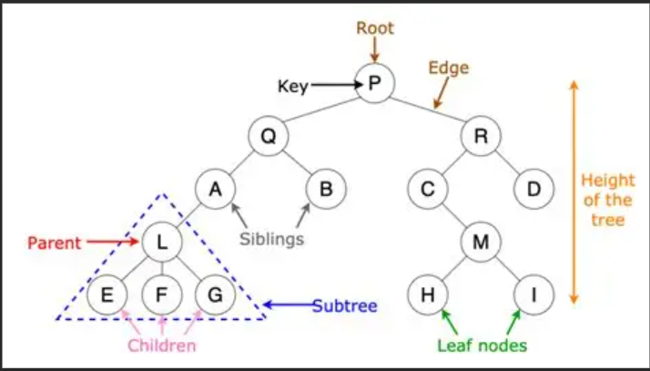
BINARY SEARCH TREES
A tree structure in computer science is used to hold data in order, and is typically drawn upside down

Slide 6
BINARY SEARCH TREES
Vocab:
Root: first node, at the top
Key: Data stored in a node
Edge: Pointer to child nodes
Leaf Node: Node that has no children
Parent Node: Node that has a child
Child Node: Node that has a parent
Subtree: Any smaller tree originating by treating a parent node as a root
Height of the tree: Number of nodes from root to lowest leaf

Slide 7
BINARY SEARCH TREES
In this lesson, we’ll be looking at a specific type of tree that follows specific rules: the Binary Search Tree
Binary Search Trees:
If a child node is less than the parent, it goes on the left
If it’s greater than the parent, it goes on the right
Each node may only have 2 children
Assume all items in a BST are unique

Slide 8
TREE STRUCTURE
A binary search tree is created by setting the first inserted node as the root
Each new node works its way through the tree until it finds a spot where it can join

Slide 9
NODE INSERTION
Let’s add nodes in this order:
25, 20, 10, 36, 22, 40, 5, 30, 12, 38, 48, 12, 28

Slide 10
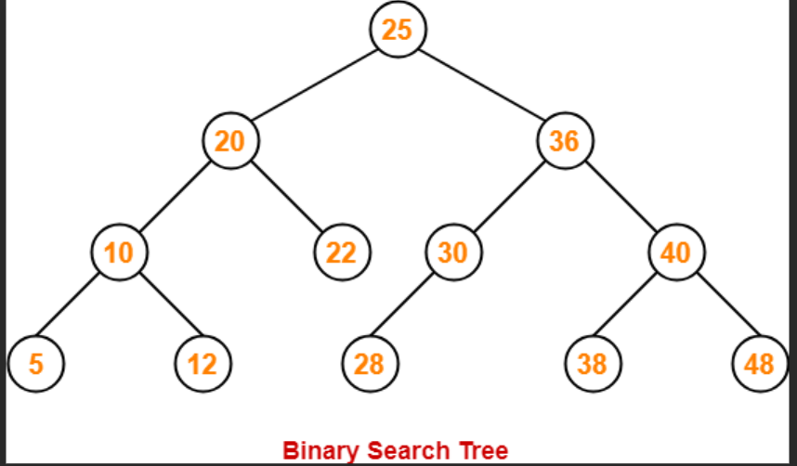
NODE INSERTION

Slide 11
MICRO MINI LAB
Create a BST by inserting nodes in the following order:
10, 15, 3, 12, 7, 1, 22, 18, 5

Slide 12
NODE SEARCH
To search for a node in a BST, follow the following algorithm:
Start at the root node
Check for null/none
Compare the node value with the key you’re searching for
If the node matches the key, search is successful
If the key is smaller than the node, proceed to the left child of the current node
If the key is greater than the node, proceed to the right child of the current node
Repeat

Slide 13
NODE TRAVERSALS
There are three different types of BST traversals
Inorder
Preorder
Postorder
The goal of a traversal is to get all of the data in a BST, sometimes to print it out

Slide 14
INORDER TRAVERSAL
For an inorder traversal, we print the data in the format Left, Middle, Right
We check a node’s left subtree before printing the data in the node we’re at, and then check the node’s right subtree
If done correctly, the printed output of a BST should be sorted

Slide 15
INORDER TRAVERSAL
What’s the output of an inorder traversal of this tree?

Slide 16
PREORDER TRAVERSAL
For a preorder traversal, we print the data in the format Node, Left, Right
We print a node’s data, then check the left subtree, then check the right subtree

Slide 17
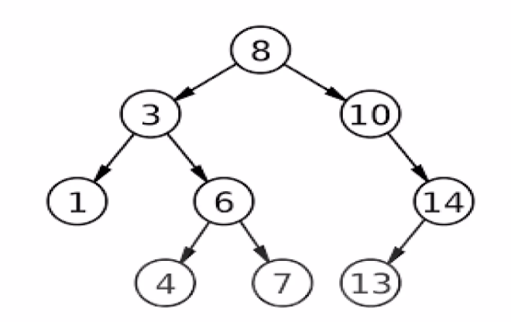
PREORDER TRAVERSAL
What would the output of a preorder traversal be for this tree?

Slide 18
POSTORDER TRAVERSAL
For a postorder traversal, we print the data in the format Left, Right, Node
We check the left subtree, then check the right subtree, and finally print the node’s data

Slide 19
POSTORDER TRAVERSAL
What’s the output of a postorder traversal on this tree?

Slide 20
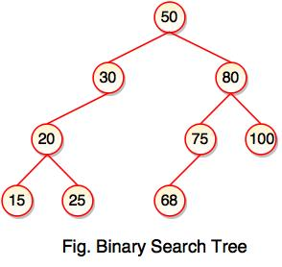
MICRO MINI LAB 2
Perform all 3 traversals on this BST

Slide 21
MICRO MINI LAB 2
Create a BST with the following data:
Ava, Alex, Bella, Catherine, Carlose, Brian, Aaron, Chloe

Slide 22
NODE DELETION
Deleting a node is certainly the hardest part of working with BSTs
Let’s break it down into steps:
1: Start at the root node
2: Search for the key to delete
3: Once you find the node, determine its type:
a: Leaf node: If the node has no right or left child
b: One child: If the node has exactly one child, either left or right
c: Two children: if the node has both a left and a right child

Slide 23
NODE DELETION
Deleting a node is certainly the hardest part of working with BSTs
Let’s break it down into steps:
1: Start at the root node
2: Search for the key to delete
3: Once you find the node, determine its type:
a: Leaf node: If the node has no right or left child
b: One child: If the node has exactly one child, either left or right
c: Two children: if the node has both a left and a right child

Slide 24
NODE DELETION
4: Delete the node based on its type
a: Leaf node: Simply remove the node from the tree by setting its parent’s appropriate pointer to None/Null
b: One child: Bypass the node by linking its parent directly to its child. If the node is a left child, update the parent’s left pointer; if a right child, update the parent’s right pointer

Slide 25
NODE DELETION
4: Delete the node based on its type
c: Two children:
Find the inorder successor (smallest value in the right subtree) or predecessor (largest value in left subtree)
Replace the value of the node to be deleted with the value of the inorder successor (or predecessor)
Delete the inorder successor (or predecessor) by repeating step 4, which now becomes a case of deleting a node with at most one child
5: Repeat the process as needed
If you deleted a successor or predecessor, repeat the deletion process for that node

Slide 26
LABBY LAB
Add the following nodes to a BST
1, 3, 5, 11, 19, 21, 44, 77, 100

Slide 27

VOCABULARY TO REMEMBER
Root
Node
Pointer
Edge
Child Node
Parent Node
Leaf Node
Subtree

